Slide 1
Patient Health Monitoring System

Slide 2
Introduction:
Healthcare technology is very popular in this pandemic situation because of coronavirus. Actually, health care technology is rapidly being revolutionized with the help of the Internet of Things (IoT). Monitoring the health status of a covid patient is a hard task because of our busy schedule and our daily work.

Slide 3
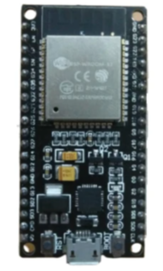
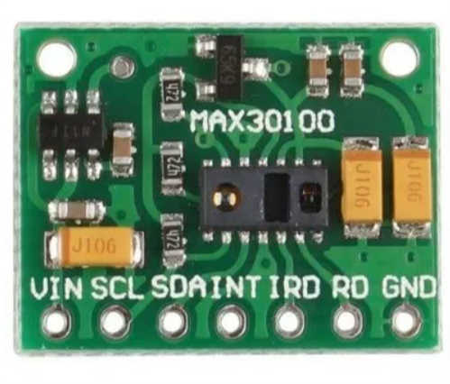
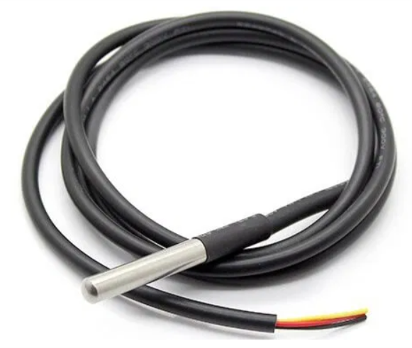
cOMPONENTS
ESP 32 Module
Temperature sensor
Pulse oximeter sensor
Jumper wires
Bread Board
Battery

Slide 4
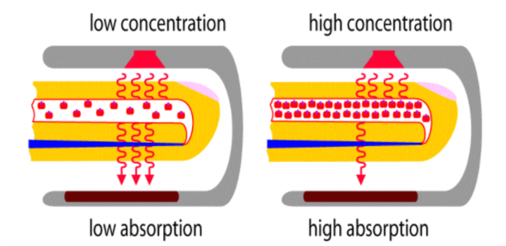
Working:
Oxygen enters the lungs and then is passed on into blood. The blood carries oxygen to the various organs in our body. The main way oxygen is carried in our blood is by means of hemoglobin. During a pulse oximetry reading, a small clamp-like device is placed on a finger, earlobe, or toe.

Slide 5
The working principle of this DS18B20 temperature sensor is like a temperature sensor. The resolution of this sensor ranges from 9-bits to 12-bits. But the default resolution which is used to power-up is 12-bit. This sensor gets power within a low-power inactive condition. The temperature measurement, as well as the conversion of A-to-D, can be done with a convert-T command. The resulting temperature information can be stored within the 2-byte register in the sensor, and after that, this sensor returns to its inactive state.

Slide 6
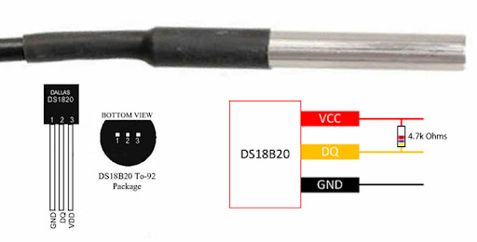

Slide 7
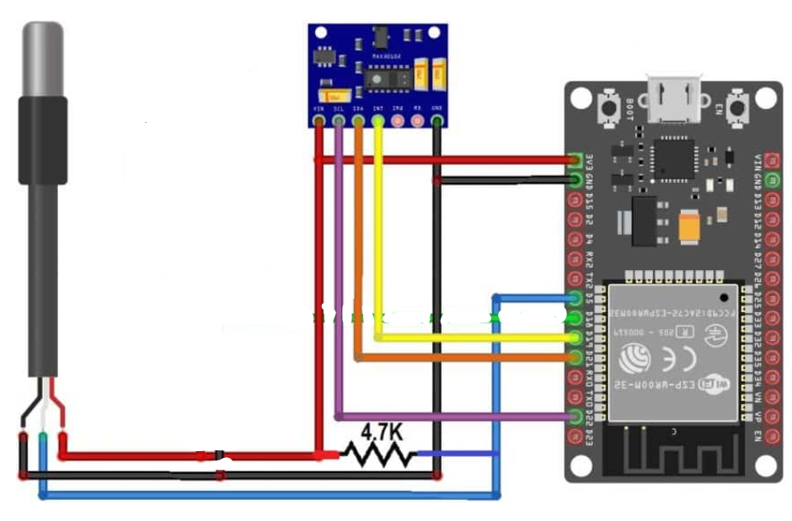
Circuit Diagram:

Slide 8
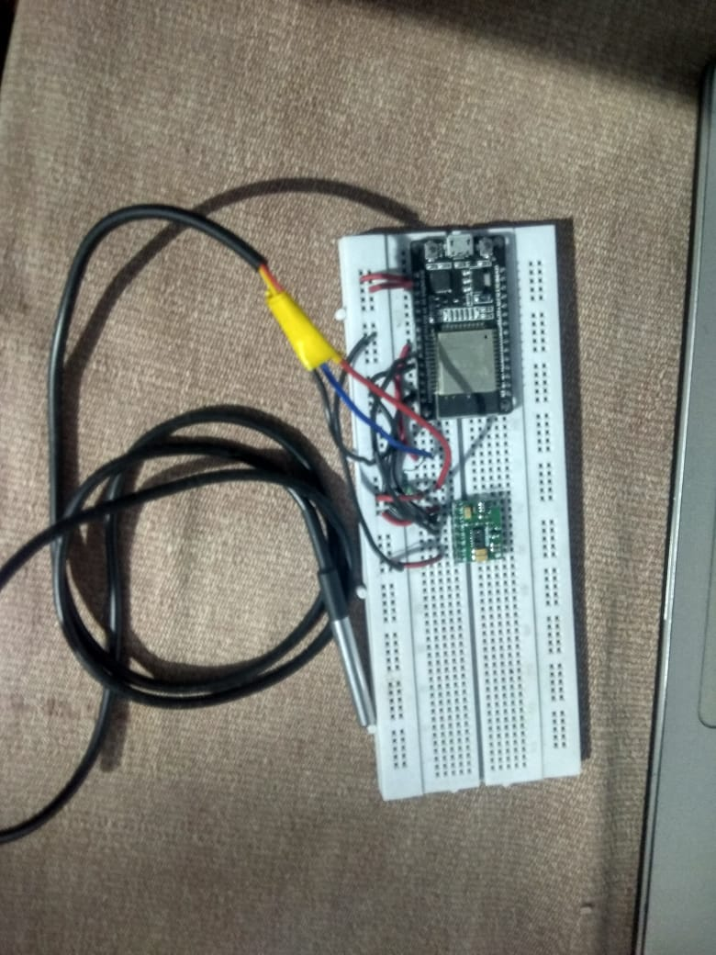

Slide 9
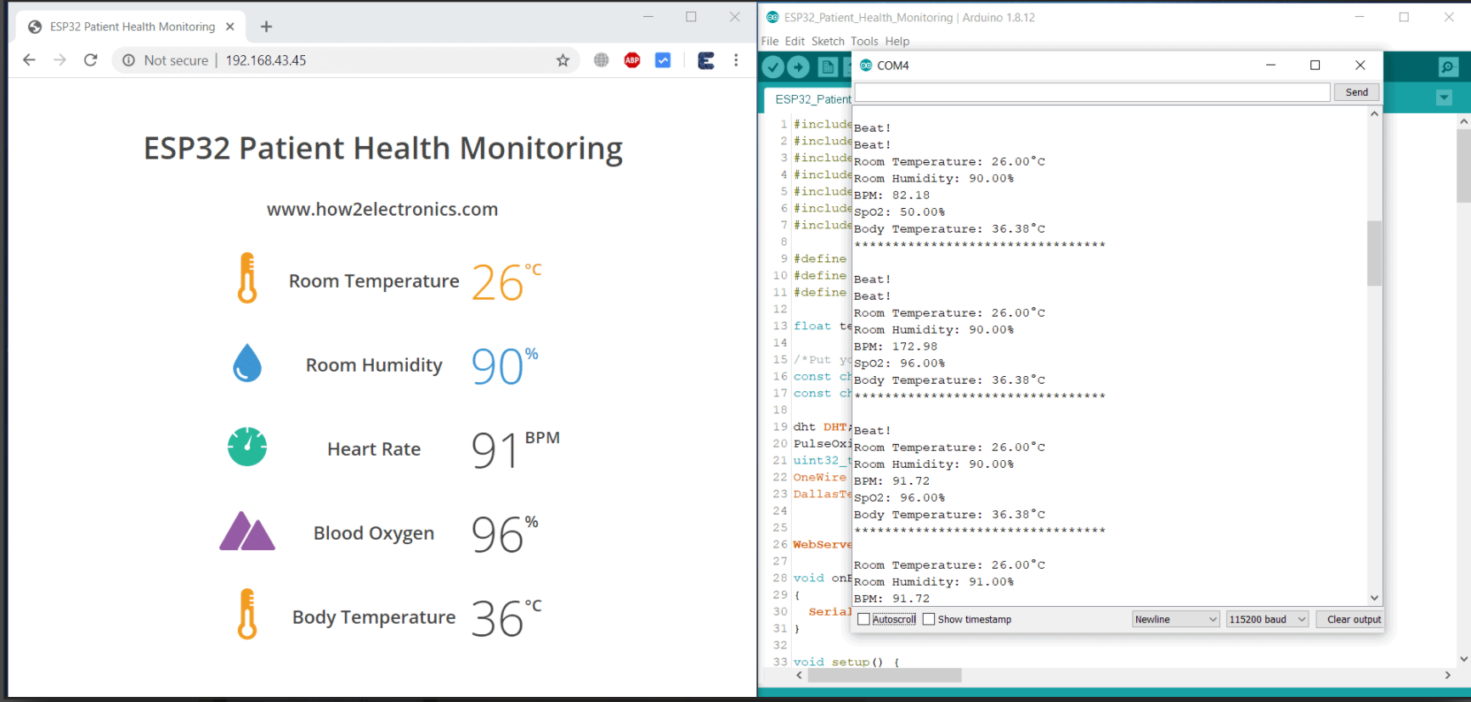
Result:

